Slide 1
This Talk
1) Node embeddings
Map nodes to low-dimensional embeddings.
2) Graph neural networks
Deep learning architectures for graph-structured data
3) Applications

Slide 2
Part 3:
Applications

Slide 3
Outline for This Section
Recommender systems
RW-GCNs: GraphSAGE-based model to make recommendations to millions of users on Pinterest.
Computational biology
Decagon: Predicting polypharmacy side-effects with graph neural networks.
Practical insights
Code repos, useful frameworks, etc
Future directions

Slide 4
RW-GCNs:
Graph Convolutional Networks for Web-Scale Recommender Systems
Based on material from:
Ying et al. Graph Convolutional Neural Networks for Web-Scale Recommender Systems. Under Review.

Slide 5
Bipartite Graph for RecSys
Items
Q
Users
Graph is dynamic: need to apply to new nodes without model retraining
Rich node features: content, image

Slide 6
Graph Neural Nets for RecSys
Two sources of information in traditional recommender systems:
Content features: User and item features, in the form of images, categories etc.
Network structure: User-item interactions, in the form of graph/network structure.
Graph neural networks naturally incorporate both!!

Slide 7











Application: Pinterest
Human curated collection of pins
Pins: Visual bookmarks someone has saved from the internet to a board they’ve created.
Pin features: Image, text, link
Boards
Representation Learning on Networks, snap.stanford.edu/proj/embeddings-www, WWW 2018
7
Task: Recommend related pins
Hundreds of millions of users
3 billion pins and boards,16 billion interactions
Board: A greater collection of ideas (pins having sth. in common).

Slide 8
Application: Pinterest
Task: Recommend related pins to users.
Source pin
Challenges:
Massive size: 3 billion pins and boards,16 billion interactions
Heterogeneous data: Rich image and text features
Board: A greater collection of ideas (pins having sth. in common).

Slide 9
RW-GCN Overview
Random-Walk GCNs = RW-GCNs
Architecture is an extension of GraphSAGE:
element-wise mean or max
multilayer perceptrons (MLPs)

Slide 10
Overview of RW-GCN Pipeline
Collect billions of training pairs from user logs.
Train system to generate similar embeddings for training pairs.
Generate embeddings for all pins.
Make recommendations using nearest neighbor search in the embedding space (in real time).

Slide 11
RW-GCN Overview
Train so that pins that are consecutively clicked have similar embeddings.
Max-margin loss:
“margin” (i.e., how much larger positive pair similarity should be compared to negative)
set of training pairs from user logs
“positive”/true training pair
“negative” sample

Slide 12
RW-GCN Efficiency
10,000X larger than any previous graph neural network application.
Key innovations:
Sub-sample neighborhoods for efficient GPU batching
Producer-consumer training pipeline
Curriculum learning for negative samples
MapReduce for efficient inference

Slide 13
Neighborhood Subsampling

Slide 14
Neighborhood Subsampling

Slide 15
Neighborhood Subsampling
Random-walk-based neighborhood
Approximates personalized PageRank (PPR) score.
Sampled neighborhood for a node is a list of nodes with the top-K PPR score.
Advantage:
Algorithm finds the most relevant nodes(item) for high degree nodes

Slide 16
Producer-consumer Pipeline
Select a batch of pins
Run random walks
Construct their computation graphs
CPU
(producer)
Multi-layer aggregations
Loss computation
Backprop
GPU
(consumer)

Slide 17


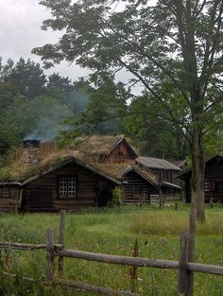

Curriculum Learning
Idea: use harder and harder negative samples
Include more and more hard negative samples for each epoch
Source pin
Positive
Easy negative
Hard negative

Slide 18
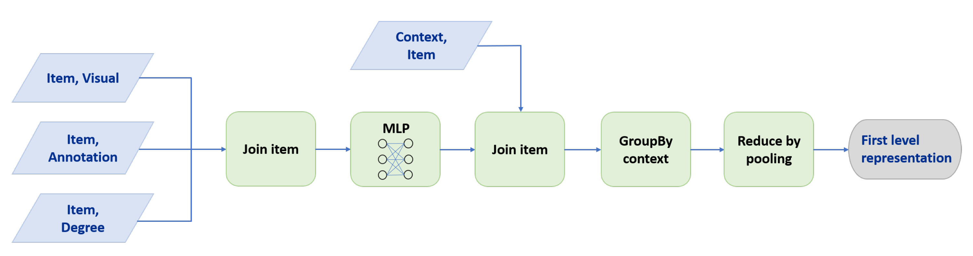
MapReduce Inference
How to efficiently infer representations on nodes we have not seen during training time?
Key insight: avoid repeated computation by sharing computation in MapReduce layers!

Slide 19
RW-GCN Performance
72% better recommendation quality than standard GraphSAGE model.
Key innovations:
Weigh importance of neighbors according to approximate PPR score.
Use curriculum training to provide harder and harder training examples over time.

Slide 20
RW-GCN Performance
Set-up: Rank true “next-clicked” pin against 10⁹ other candidates.
MRR: Mean reciprocal rank of true example.
Baselines: Deep content-based models

Slide 21
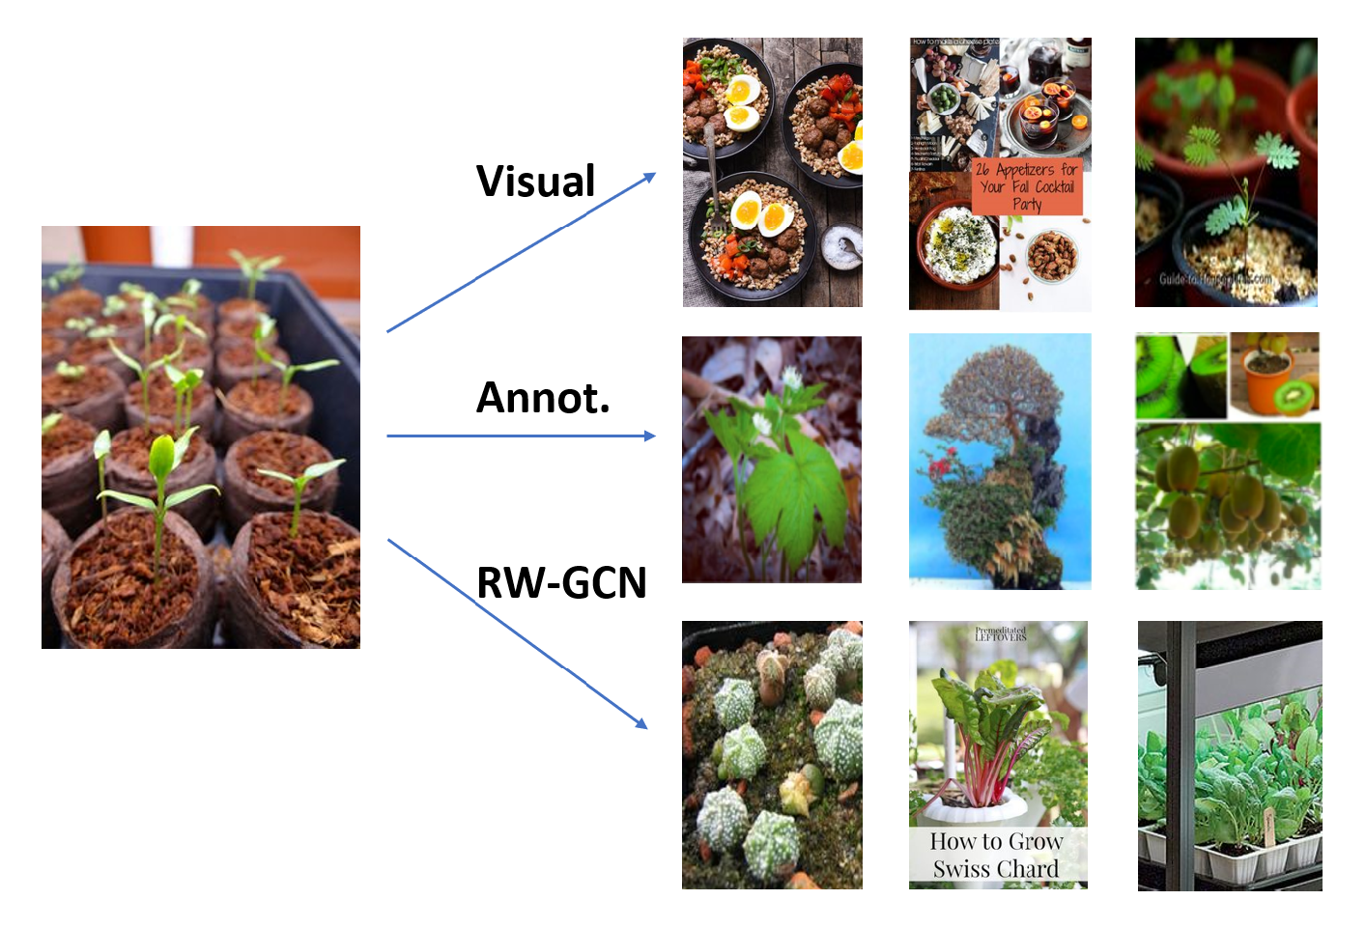
Example Recommendations

Slide 22
Decagon:
A Graph Convolutional
Approach to Polypharmacy Side Effects
Based on material from:
Zitnik et al. 2018. Modeling polypharmacy side effects with graph convolutional networks. Bioinformatics & ISMB.

Slide 23



Polypharmacy Side Effects
Goal: Predict side effects of taking multiple drugs.
Individual medications
Patient’s side effects
No side effect
No side effect
Drug combination
Polypharmacy side effect

Slide 24
Polypharmacy Side Effects
s
Polypharmacy is common to treat complex diseases and co-existing conditions
High risk of side effects due to interactions
15% of the U.S. population affected
Annual costs exceed $177 billion
Difficult to identify manually:
Rare, occur only in a subset of patients
Not observed in clinical testing

Slide 25
Modeling Polypharmacy
Systematic experimental screening of drug interactions is challenging
Idea: Computationally screen/predict polypharmacy side effects
Use molecular, pharmacological and patient population data
Guide strategies for combination treatments in patients

Slide 26
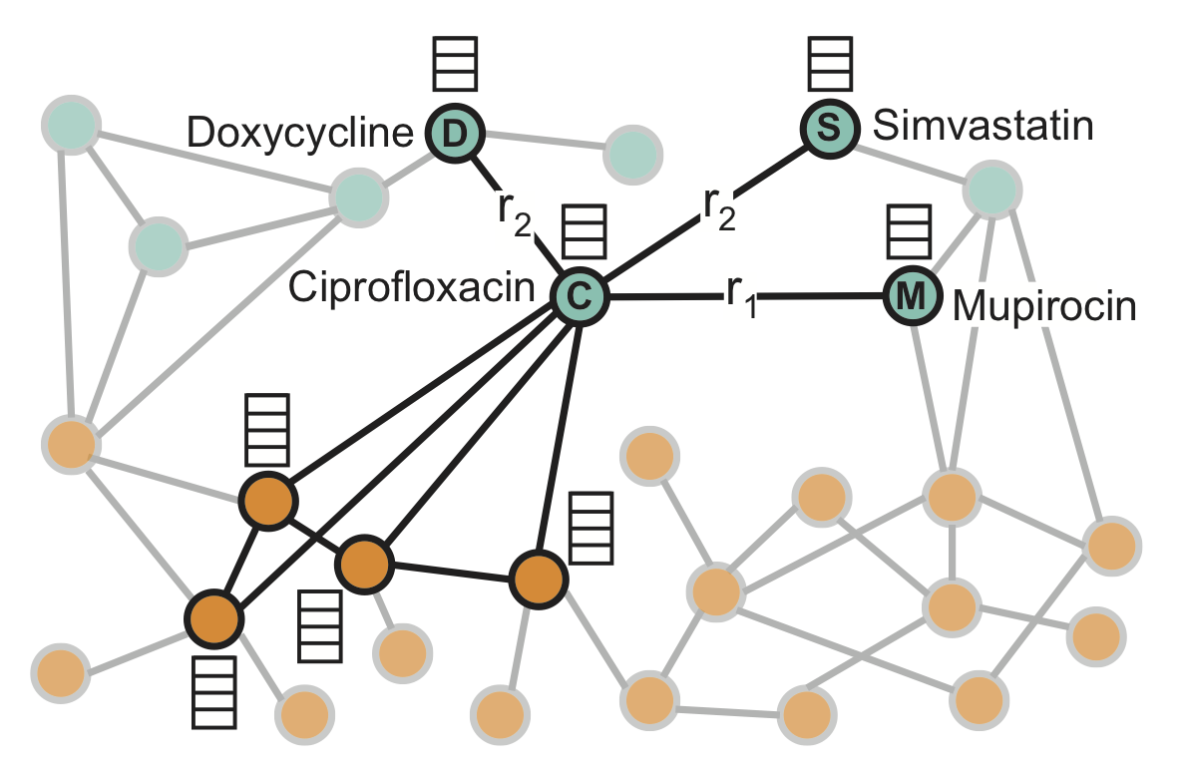
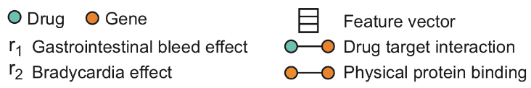
Data: Heterogeneous Graphs
Drugs
Genes

Slide 27
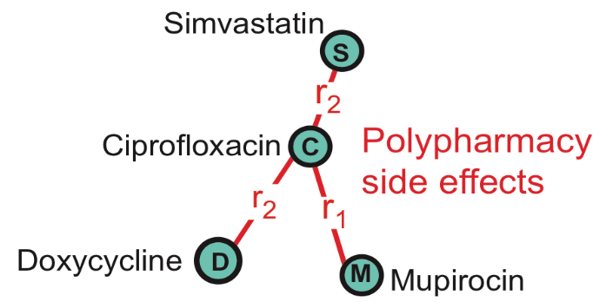
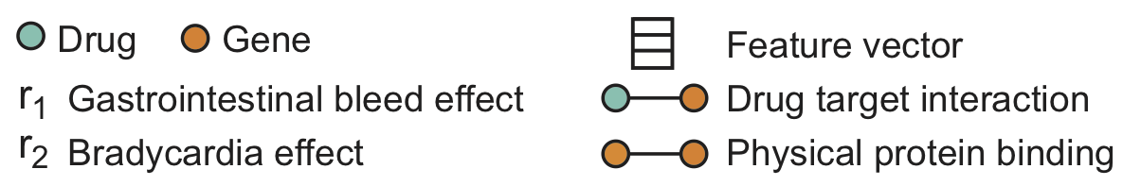
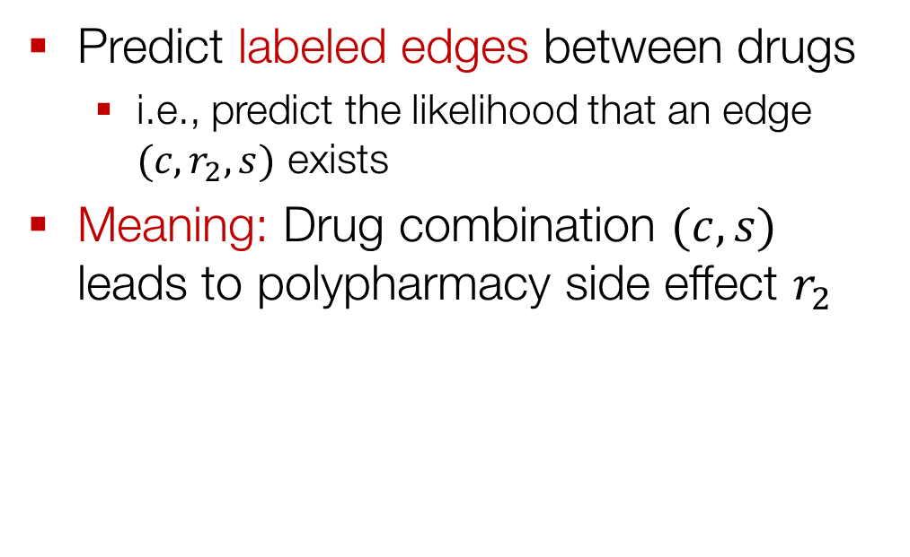
Task Description
Predict labeled edges between drugs
i.e., predict the likelihood that an edge $(c,r_{2},s)$ exists
Meaning: Drug combination $(c,s)$ leads to polypharmacy side effect $r_{2}$

Slide 28
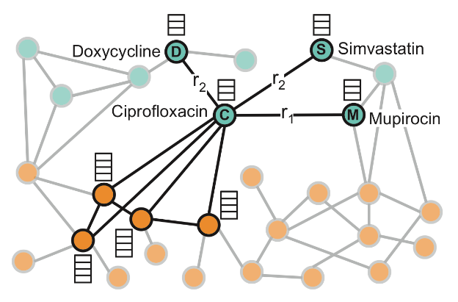
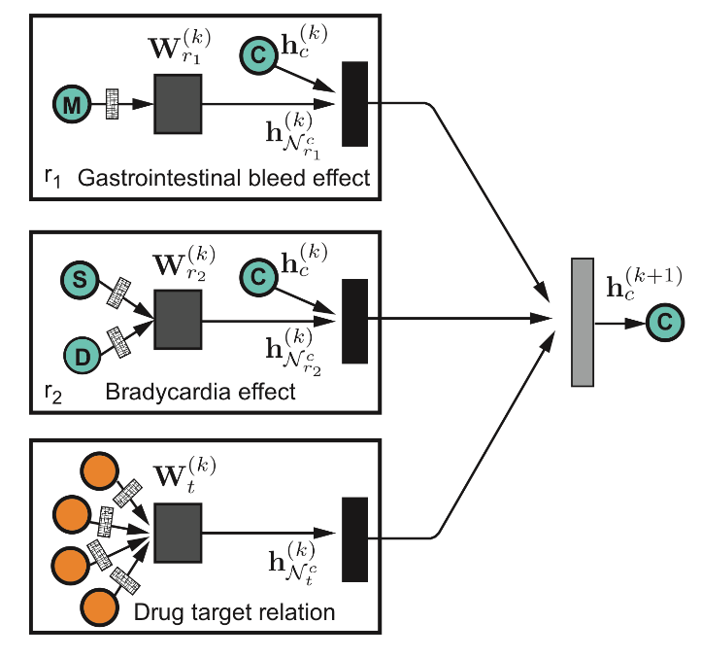
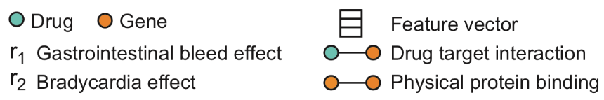
Neural Architecture: Encoder
Input: graph, additional node features
Output: node embeddings

Slide 29

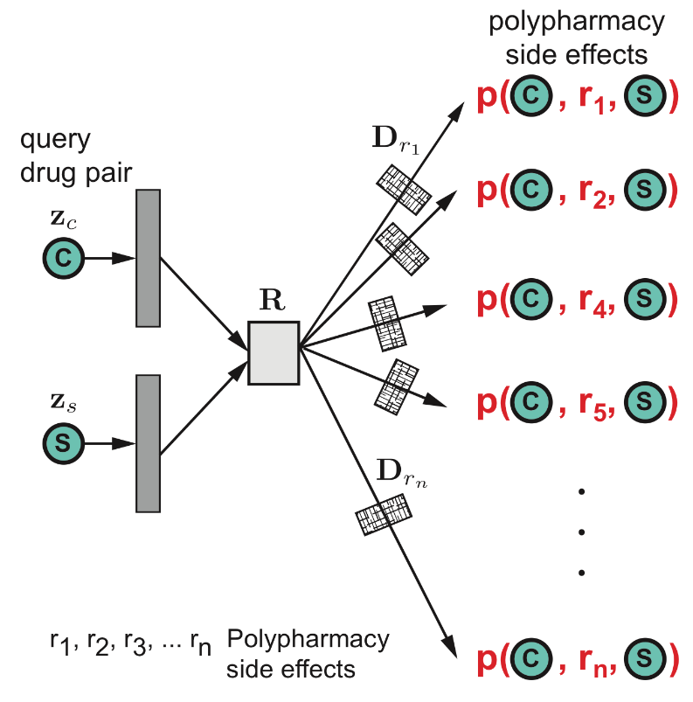
Making Edge Predictions
Input: Query drug pairs and their embeddings
Output: predicted edges

Slide 30
Experimental Setup
Data:
Molecular: protein-protein interactions and drug target relationships
Patient data: Side effects of individual drugs, polypharmacy side effects of drug combinations
Setup:
Construct a heterogeneous graph of all the data
Train: Fit a model to predict known associations of drug pairs and polypharmacy side effects
Test: Given a query drug pair, predict candidate polypharmacy side effects

Slide 31
Prediction Performance
 | AUROC | AUPRC | AP@50
Decagon (3-layer) | 0.834 | 0.776 | 0.731
Decagon (2-layer) | 0.809 | 0.762 | 0.713
RESCAL | 0.693 | 0.613 | 0.476
Node2vec | 0.725 | 0.708 | 0.643
Drug features | 0.736 | 0.722 | 0.679
Up to 54% improvement over baselines
First opportunity to computationally flag polypharmacy side effects for follow-up analyses

Slide 32
Practical Insights

Slide 33
GraphSAGE TensorFlow Ex.
A quick example: Using GraphSAGE for a supervised node classification task.
Key steps:
Preprocess network and training data.
Run GraphSAGE

Slide 34
GraphSAGE TensorFlow Ex.
Preprocessing
from networkx.readwrite import json_graph
import json
import numpy as np
data = json_graph.node_link_data(G)
with open(‘data-G.json’) as f:
f.write(json.dumps(data))
class_map = {nodes[i]: labels[i] for i in range(len(nodes))}
with open(‘data-class_map.json’) as f:
f.write(json.dumps(data))
id_map = {nodes[i]: i for i in range(len(nodes))}
with open(‘data-id_map.json’) as f:
f.write(json.dumps(data))
np.save(feats, ‘data-feats.npy’)
Save graph
Save labels
Save nodes
Save features

Slide 35
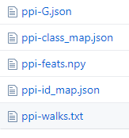
GraphSAGE TensorFlow Ex.
Example: PPI data (available in GraphSAGE repo)
Run both training and evaluation (random split of data)
Alternative models:
gcn, graphsage_seq, graphsage_maxpool
Easy to customize using Tensorflow
python -m graphsage.supervised_train --train_prefix=./ --model=graphsage_mean

Slide 36
Future Directions and Ongoing Research

Slide 37
(Sub)graph embedding
Existing approaches
Pool learned node embeddings via element-wise max/mean/sum
Add a “virtual” node representing the entire (sub)graph
Is there better pooling strategy?
Handle massive graphs?
Learn “coarsened” representations?

Slide 38
Dynamic graphs
Many graphs evolve over time:
Recommender systems
Financial transaction and event graphs
Social networks
Applications:
Predict graph evolution
Anomaly detection (e.g., fraud)

Slide 39
Dynamic graphs
Challenges:
How to efficiently and incrementally update the learned representations?
How to incorporate edge timing?
How to “forget” old/irrelevant info?

Slide 40
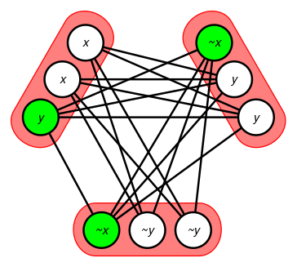
Combinatorial Applications
Efficient SAT solvers via graph embeddings (Selsam et al., 2018).
Learn embeddings of clause and literals (form a bipartite graph
Graph embeddings for neural theorem proving?

Slide 41
Reinforcement Learning
Idea: Allow agents to use node embedding information to make decisions
So far: Used for combinatorial optimization (Dai et al., 2017) and question answering (Das et al., 2018)
New directions:
Game playing?
Graph representations of dialogue state?

Slide 42
Using Graph Neural Networks
Popular Code Bases:
GCN (Tensorflow): https://github.com/tkipf/gcn/
GraphSAGE (Tensorflow): https://github.com/williamleif/GraphSAGE
GraphSAGE (PyTorch): https://github.com/williamleif/graphsage-simple/

Slide 43
This Talk
1) Node embeddings
Map nodes to low-dimensional embeddings.
2) Graph neural networks
Deep learning architectures for graph-structured data
3) Applications

